Slide 1

Multi-sensor rail track detection in automatic train operations
Master’s thesis in Data Science
Student: Attila Kovacs
1st Advisor: Lukas Rohatsch (FH Technikum)
2nd Advisor: Daniele Capriotti (M2C Expert Control GmbH)
Interim presentation: 17.10.2023

Slide 2
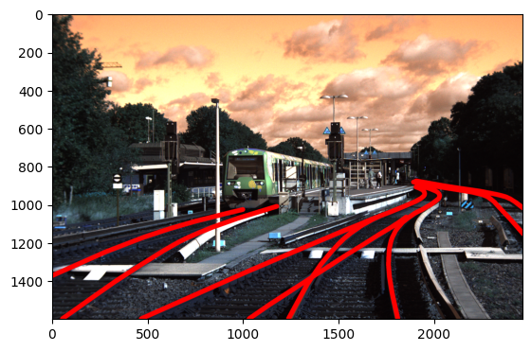
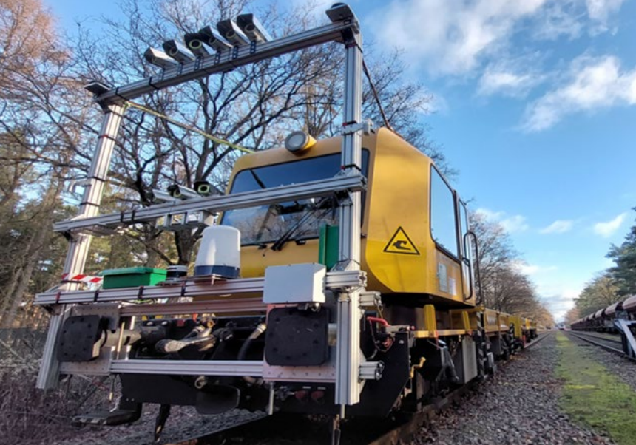
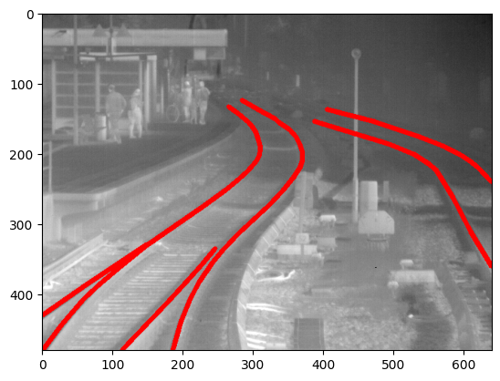
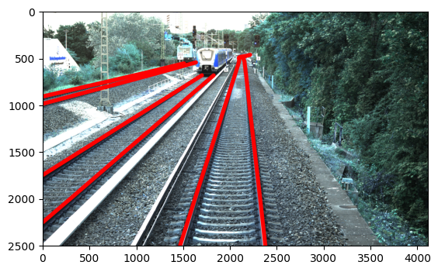
Problem setting
What is Automatic train operations (ATO) Technology is used to automate tasks that were previously performed by rail personnel (e.g., conductor)

Slide 3
Research questions
Which modelling technique and which deep learning model can be applied to solve the rail detection problem?
How can the efficiency of standard, high-resolution, and infrared cameras be compared against each other; does a higher resolution result in a higher accuracy?
What is the trade-off between model accuracy and speed of providing predictions when applied to a video stream in real time?
How do deep learning models perform compared to gradient-based thresholding approaches in terms of, e.g., accuracy (share of correctly identified objects) or F1-score (mean of precision and recall)

Slide 4
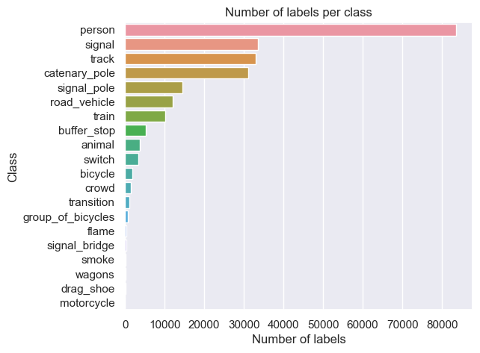
Data source
Deutsch Bahn / Digitale Schiene Deutschland (https://digitale-schiene-deutschland.de/en/news/OSDaR23-multi-sensor-data-set-for-machine-learning).
Images were generated between 09.09.2021 and 15.09.2021
Total number of images: 13.952
Sensors: 12MP RGB, 5MP RGB, IR cameras, lidar, radar, GPS, inertia sensor

Slide 5
Data source
Deutsch Bahn / Digitale Schiene Deutschland (https://digitale-schiene-deutschland.de/en/news/OSDaR23-multi-sensor-data-set-for-machine-learning).
Images were generated between 09.09.2021 and 15.09.2021
Total number of images: 13.952
Sensors: 12MP RGB, 5MP RGB, IR cameras, lidar, radar, GPS, inertia sensor

Slide 6
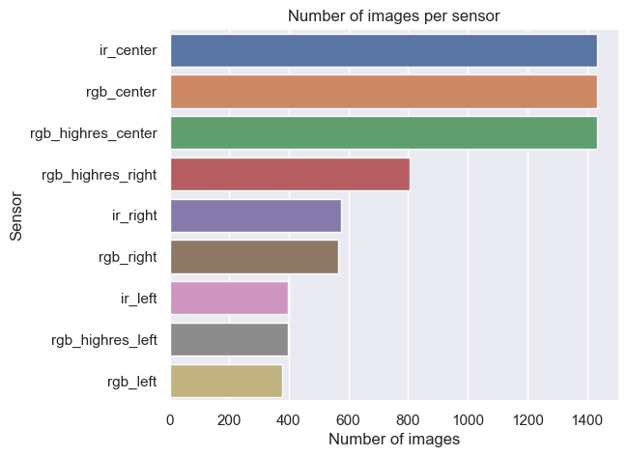
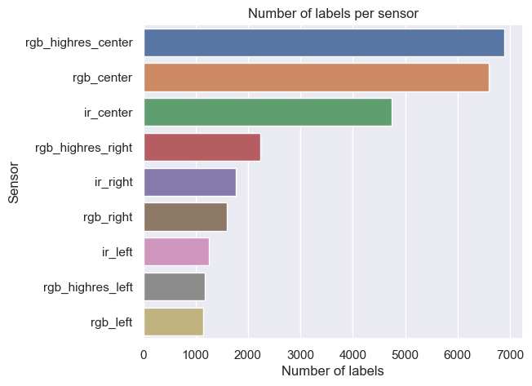
Relevant dataset (7.421 images, 27.386 labels)
Most images are from forward facing cameras
The number of labels in the image depends on sensor orientation and type

Slide 7
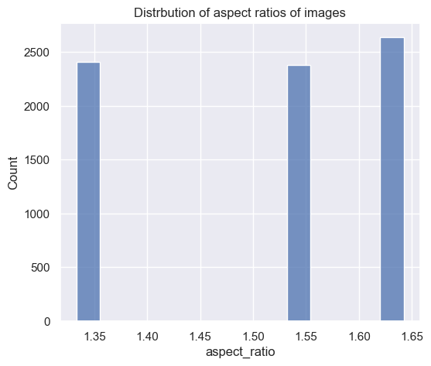
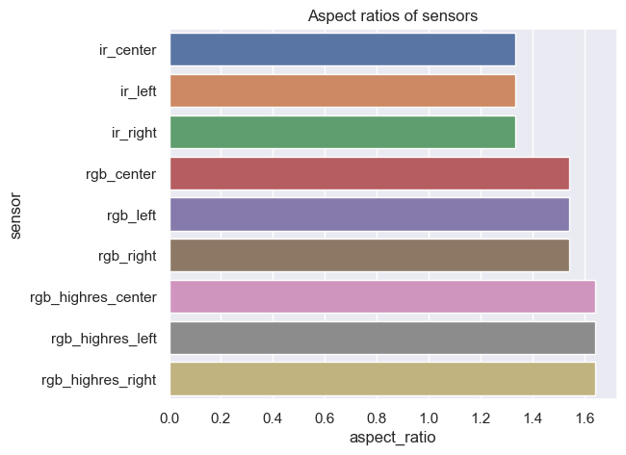
Aspect ratios (= width / height)
All images are generated with one of three camera types
Double check whether there are other images in the set

Slide 8
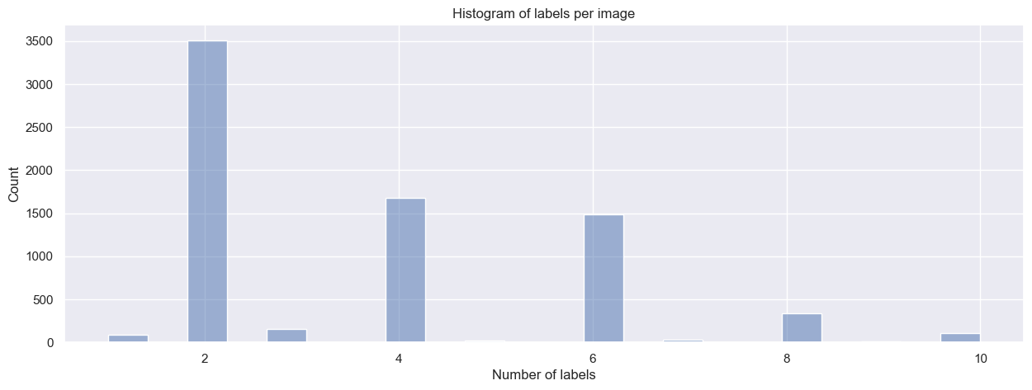
Labels per image
Most tracks are labelled in pairs
However, there is also a small number of images with uneven number of tracks

Slide 9
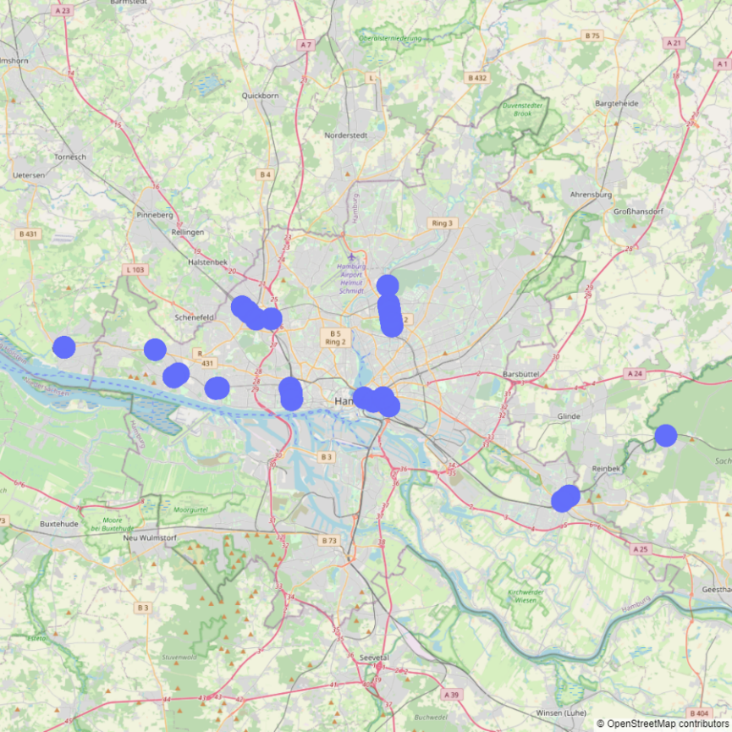
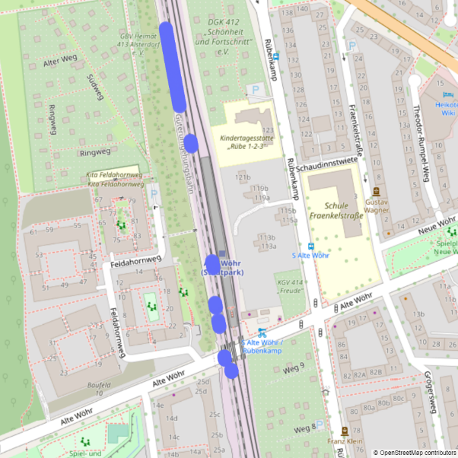
Location of images
All images/videos were taken around Hamburg

Slide 10
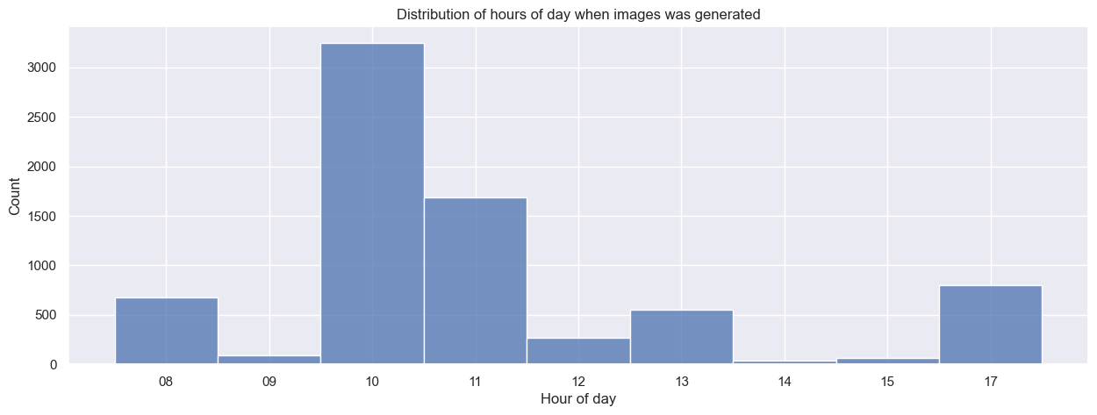
Time of images
All images were taken between 8 AM and 5 PM

Slide 11
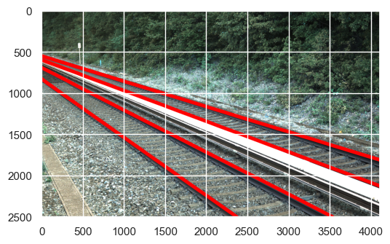
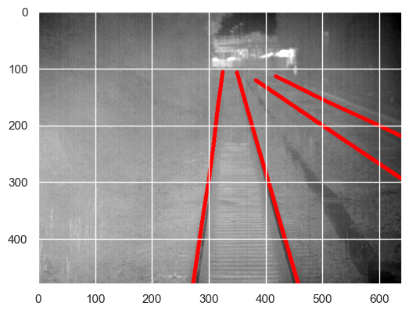
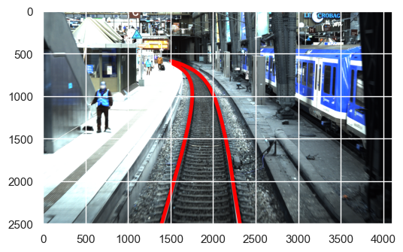
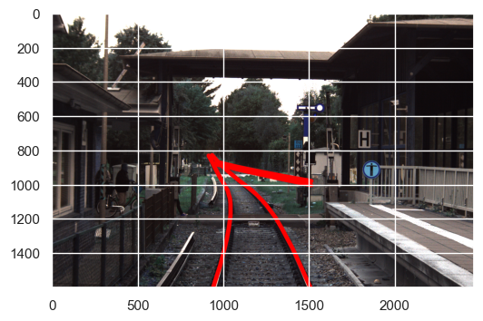
Some examples of labeled images

Slide 12
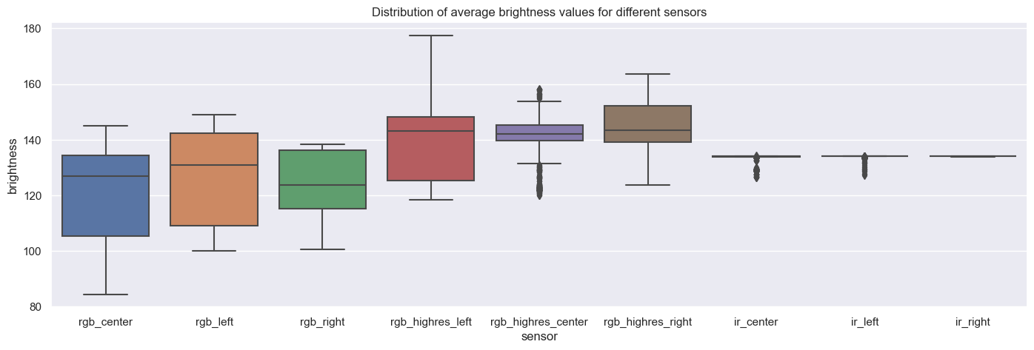
Brightness of images
RGB images are darker thank high resolution images (not pixel related)

Slide 13
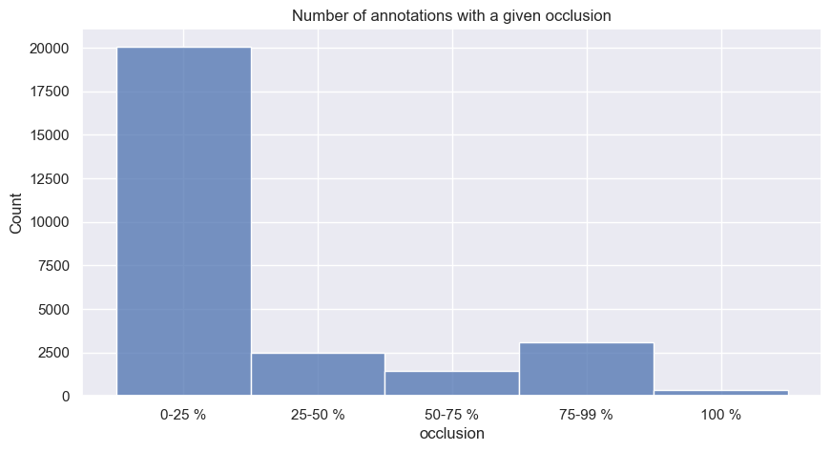
Occlusion
Most of the labels have a good visibility

Slide 14
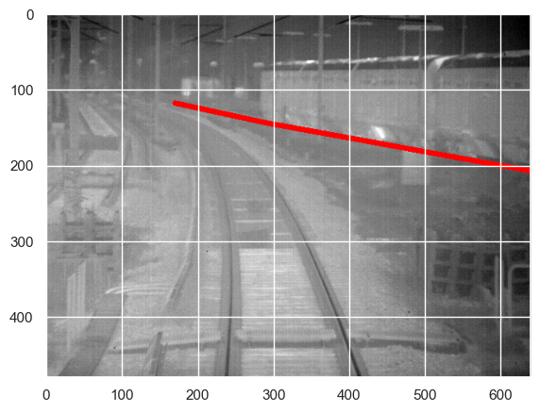
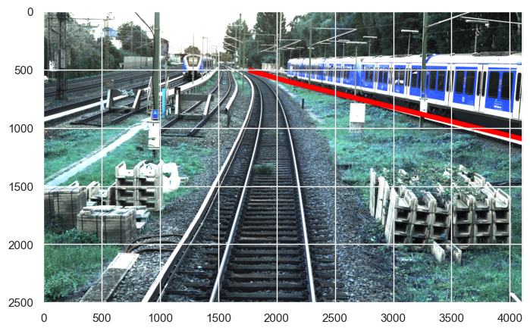
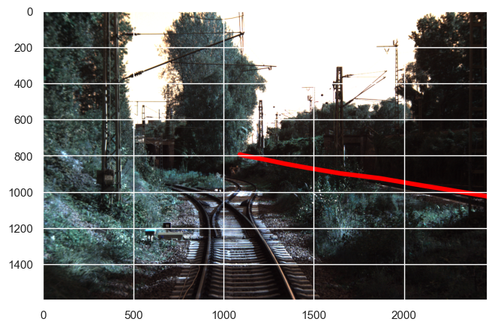
Examples of occlusion = 100%
Most of the labels have a good visibility

Slide 15
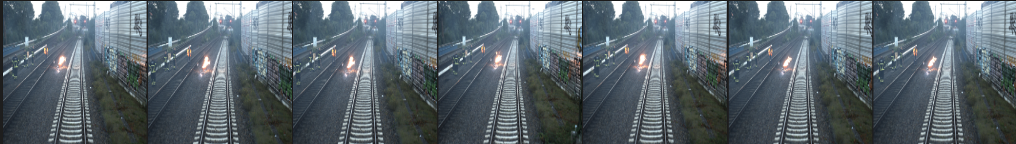
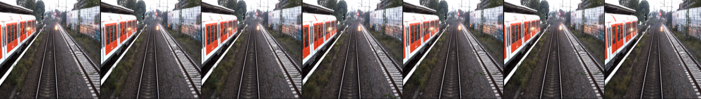
Splitting into trail, validation and test set
Many images are very similar which needs to be taken into account

Slide 16
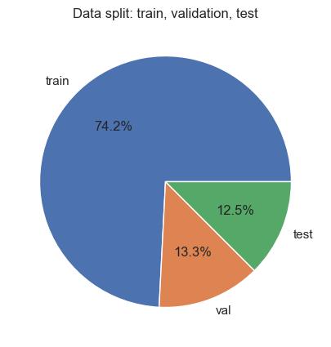
Splitting data set
Given the large similarity between images, we split data by randomly assigning videos to either train, validation or test set
Advantage: fair testing as we have a „data leakage“ between the sets
Disadvantage: validation batches might have low variety

Slide 17
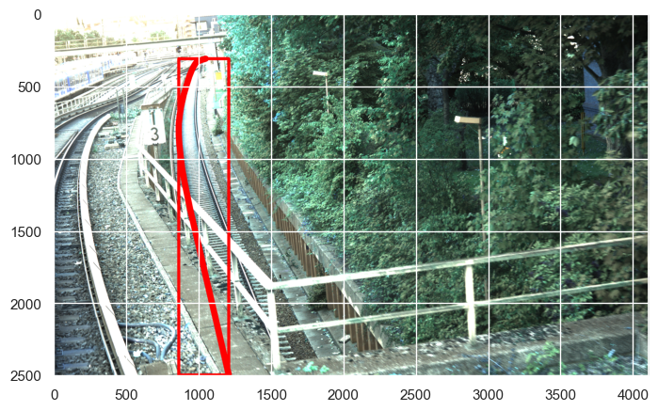
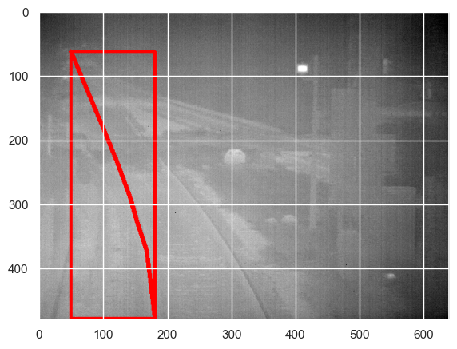
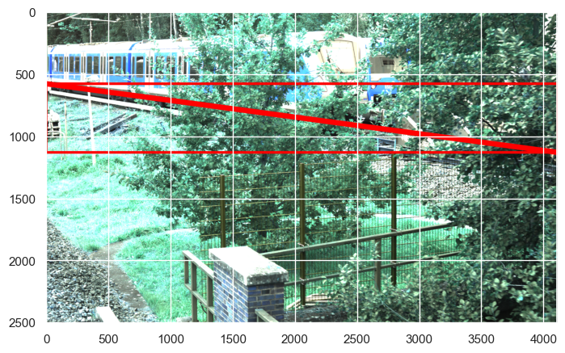
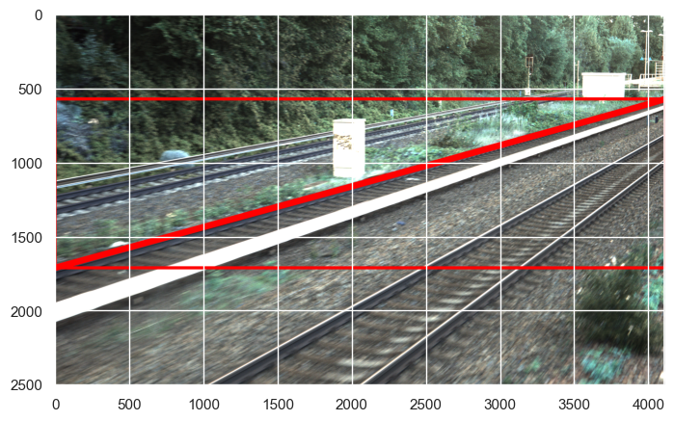
Orientation of labels

Slide 18
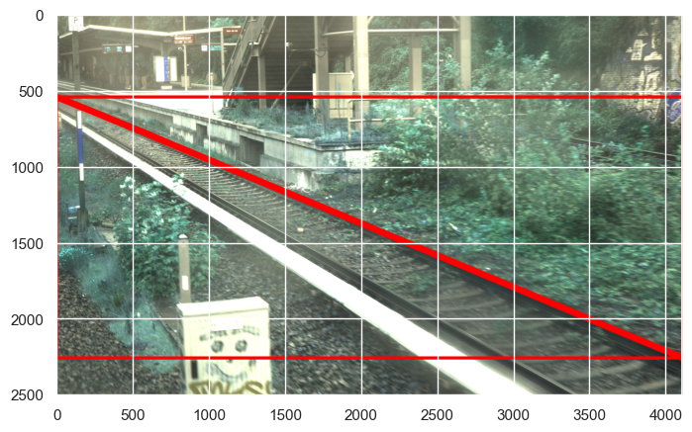
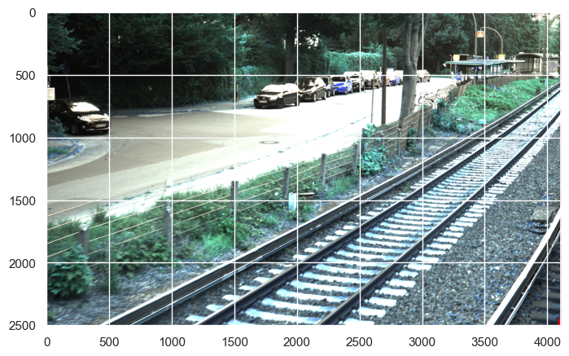
Size of labels

Slide 19
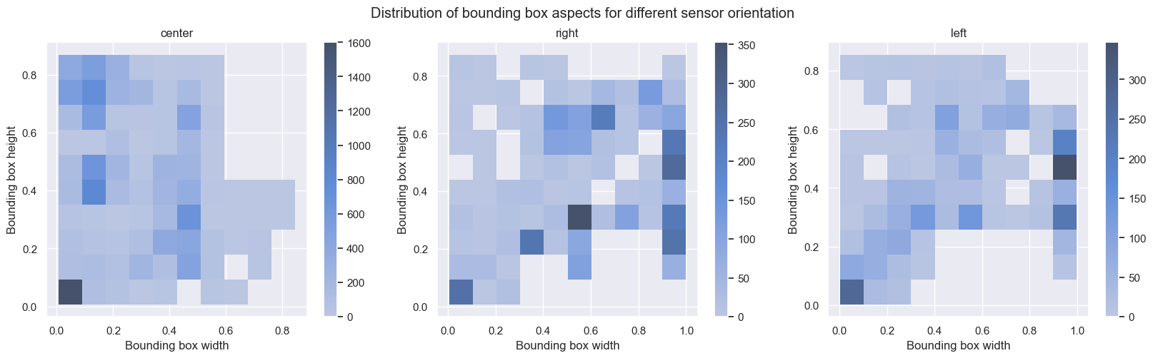
Histogram of bounding box shapes and sizes
Bounding boxes format is related to the orientation of sensors

Slide 20
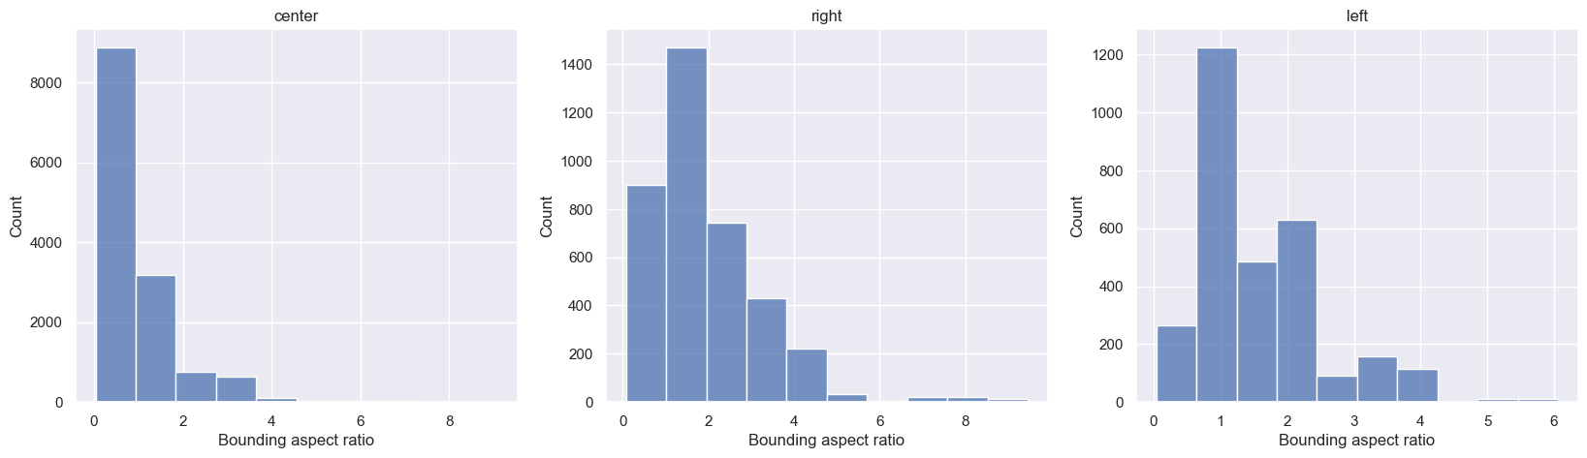
Aspect ratio of bounding boxes

Slide 21
Next steps
Generate label masks for images
Establish baseline
Research gradient thresholding approaches
Select and implement approach
Analyze results
Select image segmentation model

Slide 22
Q&A

